Slide 1








x$_{1}$
$$θ_{ij}^{1}$$
x$_{2}$
.
.
.
.
.
.
.
x$_{n}$
$$σ(θ_{1}^{1}·x+b_{11})$$
$$θ_{1}^{2}(t)$$
$$σ(θ^{2}·a+b_{11})$$
Output
$$θ_{2}^{2}$$
$$σ(θ_{2}^{2}·x+b_{12})$$
Poor performance
Hard task to build ‘by hands’ the gradients Even for a so raw network

Slide 2
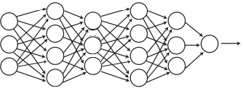
How to improve performances?
MORE LAYERS
More model expressivity
How to build gradients ‘by hands’ here?
I think impossible (in adequate times)!

Slide 3
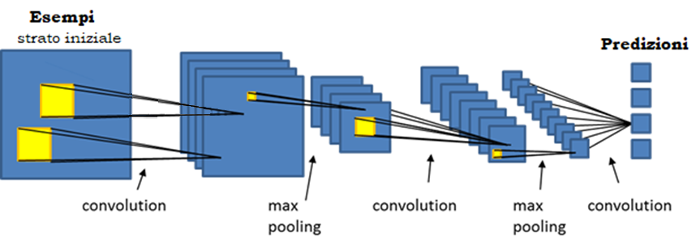
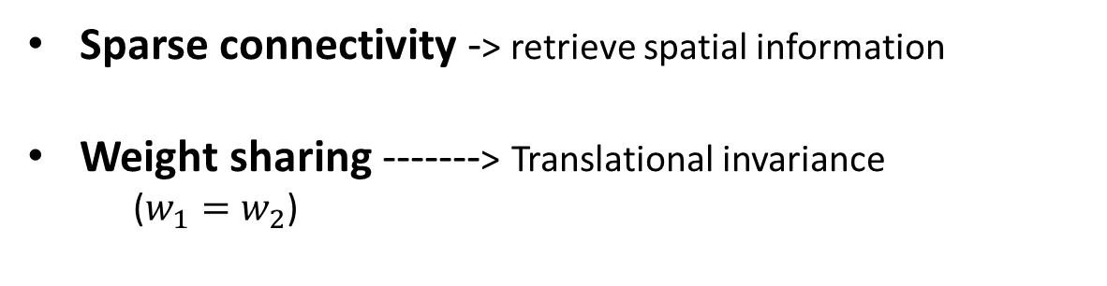


CNNs
$$w_{1}$$
$$w_{2}$$
Sparse connectivity -> retrieve spatial information
Weight sharing -------> Translational invariance
($w_{1}=w_{2}$)

